Slide 1
Timing VIX futures
Sample Research Project Presentation

Slide 2
#1. Frame the Idea
We test a strategy that sells volatility by selling short VIX futures contracts
  Implements trades on a daily basis
  Uses Ridge regression to create a forecast for the expected return on the front-month VIX futures contract every day
  Based on this signal, we will either short the contract or stay in cash
  Compare to a strategy that constantly shorts VIX front-month futures

Slide 3
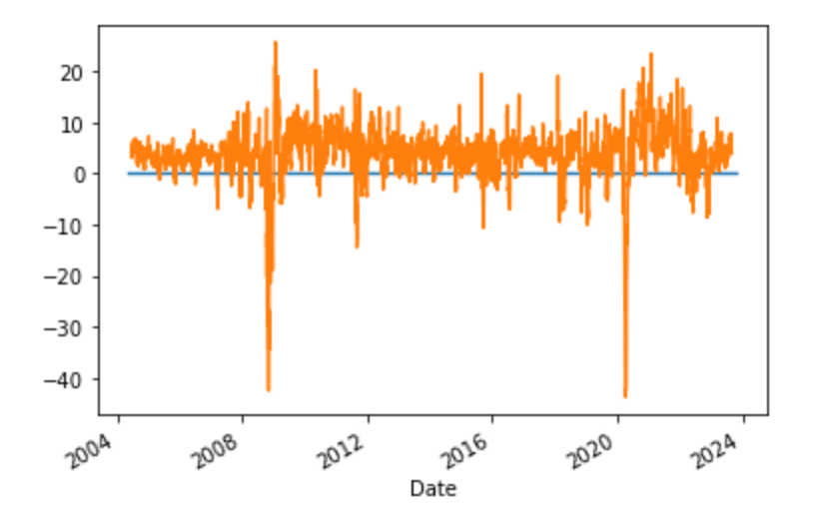
#2. Discuss the Finance Theory
Well-documented premium to shorting volatility
  Option buyers willing to pay a high price for downside protection
  Well-documented VRP – averaged annualized realized volatility is 3.54% below the VIX implied volatility

Slide 4
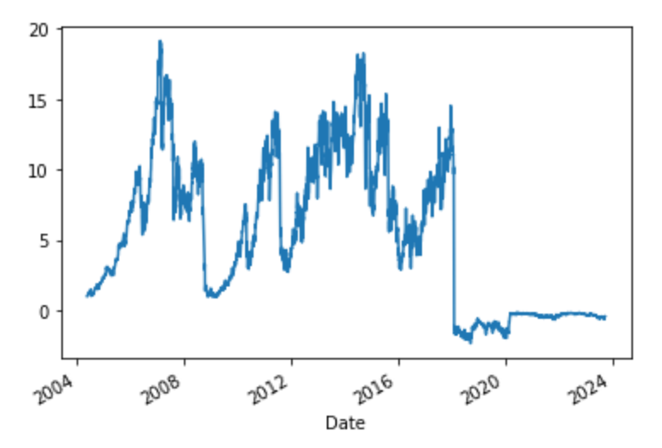
#2. Discuss Finance Theory
Return to constantly shorting front-month VIX futures:
  Annual excess returns: 42.3%, StDev: 94.3%, Sharpe ratio: 0.45, Skew: -2.52

Slide 5
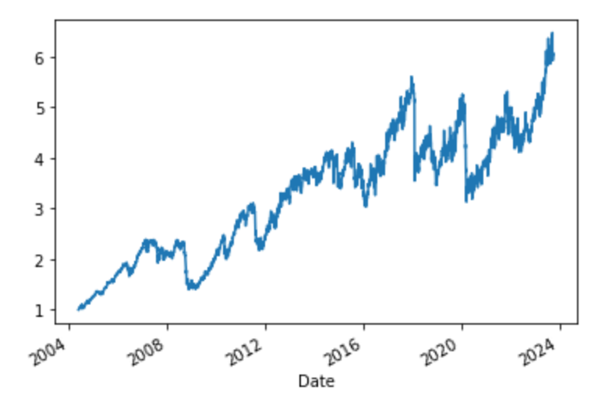
#2. Discuss Finance Theory
Silly to run a strategy at 94% vol; what about 25% VIX, 75% t-bills
  12.1% return, 23.5% stdev, 0.51 sharpe, -2.52 skew; min daily ret -28.1%

Slide 6
#3: Describe Strategy
Our strategy will use a Ridge routine to forecast daily returns on the VIX futures in an effort to avoid these large negative returns, reduce skewness, and enhance Sharpe ratios
Strategy: short VIX front month future contract with 50% weight unless a large positive return is forecast for VIX; then go 100% t-bills
Alternate specification: potentially go long the VIX futures if opportunity is large enough (high hurdle); also try Lasso

Slide 7
#3: Describe Strategy (data)
Y-value: front month VIX futures contract (daily)
  May 2004 through October 2023
X-values (23 total):
  lags of S&P 500 return (1, 3, 5, 22, 66, 132 days)
  VIX moving averages: difference between VIX and (3, 5, 22, 66) day MA
  VRP: difference between VIX level and lagged 5-day volatility (2 measures)
  VIX future returns: lagged 1, 5, and 22 day returns on VIX futures
  VIX slope: difference between VIX and VIX future; VIX future and 2nd future
  Macro predictors: e/p, inflation, BAA spread, ntis

Slide 8
#3: Describe Strategy (process)
Process: read in all predictors and normalize
Run Ridge with CV specification; calibrate model first 252 days and then do walk-forward out of sample. Store forecasts.
Strategy will short front-month VIX futures unless forecasted return for the VIX future is above 3%
Reevaluate on a daily basis

Slide 9
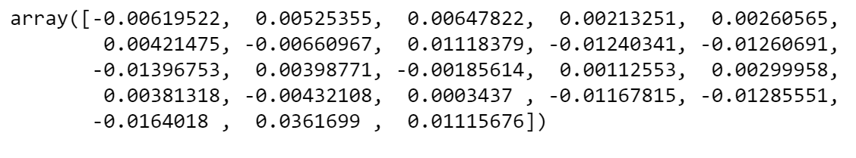
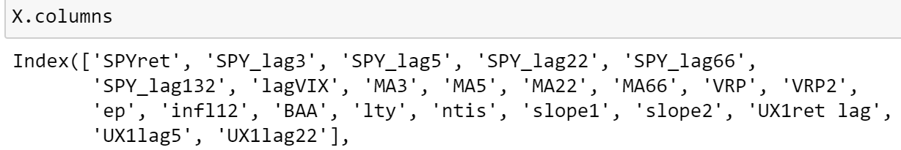


















#4: Results (Regression Coefficients)

Slide 10
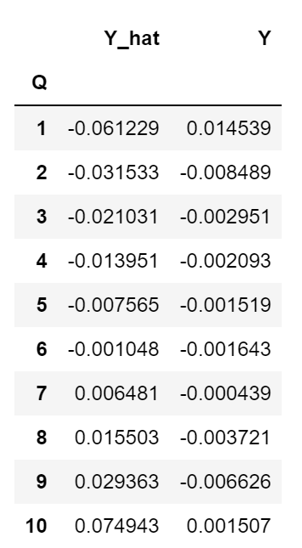
#4: Results (quintile forecasts)
Positive returns for VIX futures (Y) at both high forecasted values and low forecasted values
Evidence of non-linearities

Slide 11
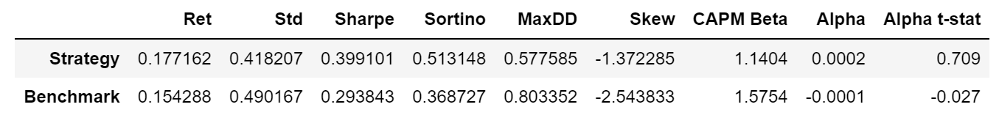
#4: Results – Portfolio Results

Slide 12
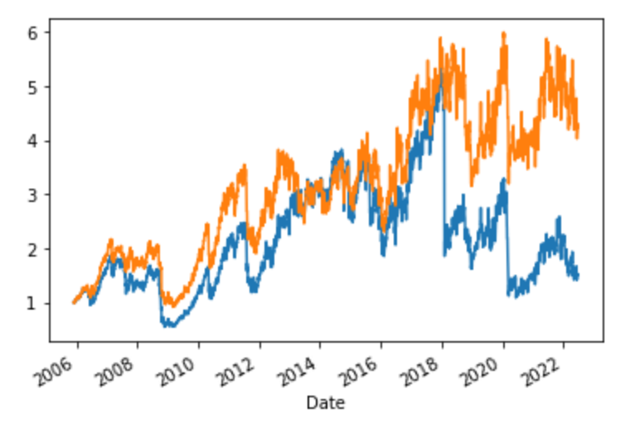
#4: Results – Cumulative Returns
Orange = strategy; Blue = benchmark

Slide 13
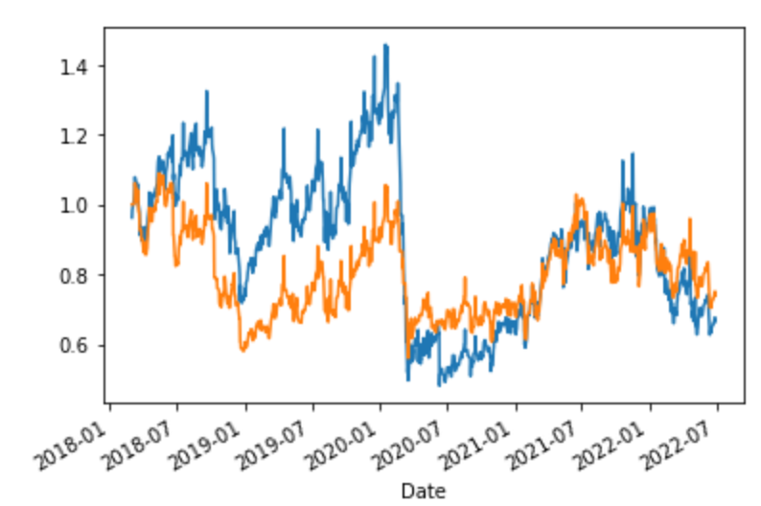
#4: Results -- Subsample
Since March 2018

Slide 14
#4: Results -- Subsample
Since March 2018
Strategy:
  Mean ret 6.29%
  Stdev 49.2%
  Sharpe 0.11
Benchmark:
  Mean ret 6.81%
  Stdev 56.3%
  Sharpe 0.00

Slide 15
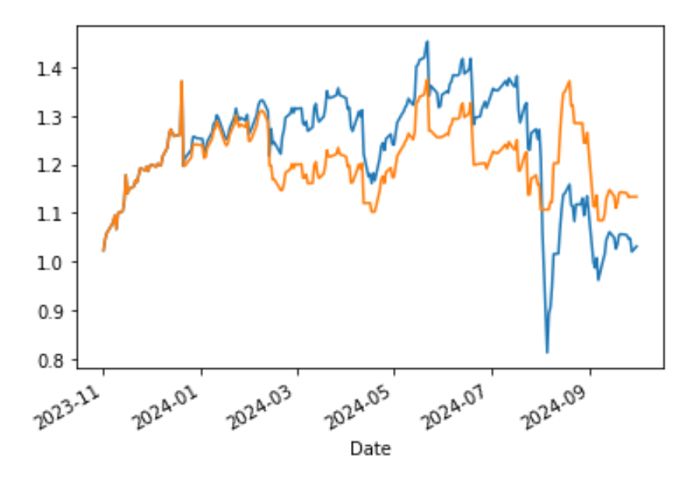
Out of Sample Test (Updated 2024)
Original study ended in 2023; let’s look at returns from 10/31/2023-10/31/2024

Slide 16
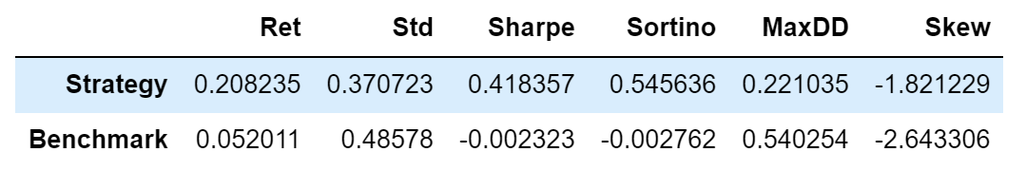
Out of Sample Test (Updated 2024)
Unconditional vol selling was not a good strategy; but the timing component has worked, avoiding the large drawdown in August 2024

Slide 17
Further Work
Account for non-linearities and interactions
  Especially between slope and momentum factors, level factors
Choose between front and second month contract – or both?
Adjust for time to expiration
  May see different behavior near expiration day
  Normalize for days remaining, especially for slope
Additional data
  Incorporate forecasts of future volatility?
Think about how to assess the crowding effect
Measure number of trades and transaction costs

Slide 18
Final Notes about Your Presentations
Description here is sparse; your written paper should go into a lot more detail around everything
  After hearing the presentation, I should be able to understand what you do and why, and the general results
  After reading your paper I should be able to (more or less) recreate your results from scratch
These slides are “adequate”. Yours could be better.

